Slide 1

Spotify data for songs 1950-2020
Team 21

Slide 2
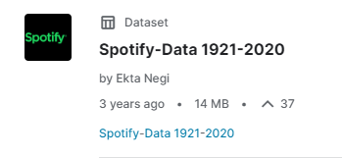
The Dataset
Why did we choose the dataset we did (Spotify Song Data 1920 - 2020)?
How did we optimise the dataset?
What fields are within the data set?

Slide 3
What are these fields
The fields themselves represent data that the Spotify API uses to assign a value to each songs features.
What each of these fields represent

